Slide 1
Q4 and FY 2020 Shareholder Update Presentation
North America’s most advanced provider of secure data intelligence solutions to drive your business forward.
April 29 2021

Slide 2

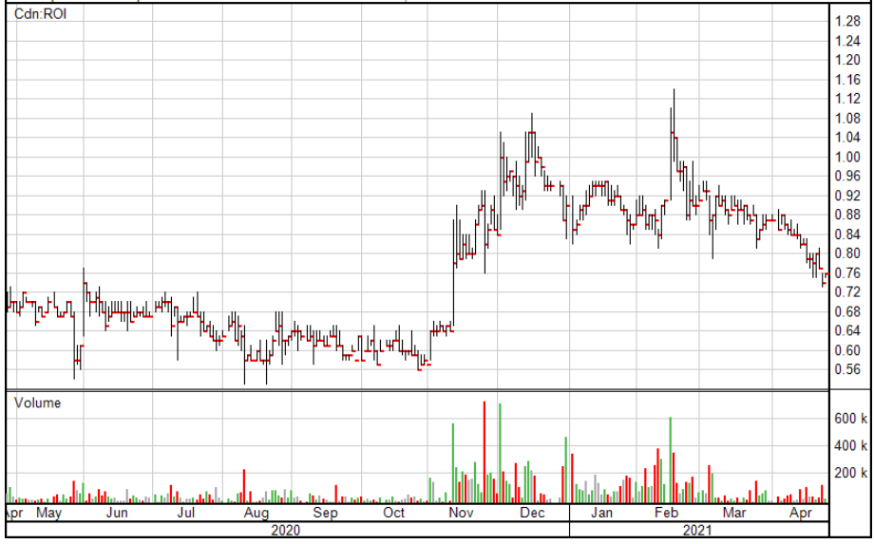
Company Snapshot
Route1 Inc.
Incorporation Year | 2004
Stock Price | CAD $0.80 as at April 21, 2021
52 Week High / Low | CAD $0.53 to $1.14
Fully Diluted Common Shares Outstanding | 40 million
Market Capitalization | CAD $32 million
Employees | 57
FY 2020 Revenue | CAD $24 million
FY End | December 31
Offices | Scottsdale, AZ Denver, CO Washington, DC Boca Raton, FL Cincinnati, OH Chattanooga, TN Toronto, Canada
Ticker | OTCQB: ROIUF TSXV: ROI
Page 2

Slide 3

Legal Notices
This presentation contains statements that are not current or historical factual statements that may constitute forward-looking statements. These statements are based on certain factors and assumptions, including, expected financial performance, business prospects, technological developments, and development activities and like matters. While Route1 Inc. (“Route1” or the “Company”) considers these factors and assumptions to be reasonable, based on information currently available, they may prove to be incorrect. These statements involve risks and uncertainties, including but not limited to the risk factors described in reporting documents filed by the Company. Actual results could differ materially from those projected as a result of these risks and should not be relied upon as a prediction of future events. The Company undertakes no obligation to update any forward-looking statement to reflect events or circumstances after the date on which such statement is made, or to reflect the occurrence of unanticipated events, except as required by law. Estimates used in this presentation are from Company sources.
© 2021 Route1 Inc., 8 King St. East, Suite 600, Toronto, Ontario M5C 1B5 Canada. All rights reserved.
See https://www.route1.com/terms-of-use/ for notice of Route1’s intellectual property.
Not for dissemination in the United States or United States newswire services.
Page 3

Slide 4


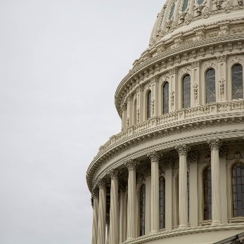
Who Is Route1? We’re Building Smart, Secure…
Route1 builds smart, secure communities by combining our expertise in cyber security with our suite of intelligent solutions including video solutions, information security, and data storage.
Route1 builds smart, secure enterprises by utilizing our data acquisition and analytics expertise to leverage your information through new technologies and engineering Industrial Internet of Things (IIoT) ecosystems
Route1 builds a smart, secure government by protecting your mobile workforce against cyber security threats via our patented MobiKEY technology and DEFIMNET.
Communities
Enterprises
Government

Slide 5





We Are an “Outcomes” Based Company
We deliver exceptional client outcomes.
Data Security and User Authentication
Our IP: MobiNET (DEFIMNET), MobiKEY, DerivID
Our
Four Pillars
of Strength
Data Acquisition and Analytics Technology
Our IP: MobiNET, ActionPLAN, ScreenSTOP
What we resell: Fixed and mobile video systems including ALPR
Data Visualization
What we resell: Fully rugged and semi rugged laptops, tablets, and handhelds, along with vehicle mounts, modems, and other accessories
New Technology and Services
Our in-house core capability: (a) Software development, (b) managed hardware services including TaaS, (c) on-premise client connectivity, and (d) hardware break & fix
Page 5

Slide 6
Annual Operating Performance
In 000s of CAD Dollars | FY 20 A | FY 19 A | FY 18 A | FY 17 A | FY 16 A
Revenue | 29,707 | 24,009 | 26,231 | 6,070 | 7,447
Subscription Revenue and Services | 9,574 | 7,455 | 6,209 | 5,698 | 7,080
Gross Profit | 11,072 | 9,031 | 7,499 | 4,745 | 5,973
Gross Margin % | 37% | 38% | 29% | 78% | 80%
Expenses | 9,936 | 8,214 | 6,892 | 4,736 | 5,231
Operating Income | 1,136 | 817 | 607 | 9 | 742
EBITDA | 2,460 | 1,941 | 1,275 | 401 | 1,203
AirWatch Litigation | (1,610) | (1,289) | (841) | (270) | (56)
Fraud | (597) | - | - | - | -
Net (Loss) Income | (1,707) | (554) | (434) | (610) | 330

Slide 7
“Noise” Below the EBITDA Line – Concluded
AirWatch Litigation
Patent litigation expenses consist of legal fees and other third-party costs incurred to prosecute cases of alleged patent infringement. Legal costs to prosecute the alleged patent infringement complaint were expensed as incurred with any potential gain on settlement to be recognized on realization.
Patent litigation expenses for the year ended December 31, 2020, were $1,609,807.
  In 2020, patent litigation expenses include the costs related to the settlement with AirWatch net of the recovery of the litigation financing liability.
On December 29, 2020, a settlement to conclude the litigation in both Canada and the United States was reached whereby Route1 would pay US$1,400,000.
Fraud
In Q3 2020, Route1 was the victim of a fraud in the United States perpetrated by a group posing as legitimate customers with the goal of purchasing rugged devices. As soon as Route1 became aware of the fraud, it took steps to contact and then work with both federal and local authorities.
The reserve, after recovery of some of the rugged devices from these transactions, was $597,401 (US$469,212). The expense related to the reserve is included as part of Other Expenses.
Route1 has paid its vendor of record the full amount and has no further financial obligations as a result of the fraud.
Route1 is pursuing coverage from its insurers to mitigate the loss incurred as a result of the fraud.

Slide 8
FY 2020 Commentary
24%
22%
23%
Total revenue increased by 24% over FY 2019.
Application software revenue increased by 22% over FY 2019.
Gross profit increased by 22% over FY 2019..
EBITDA
Net Income
Equity Raise
Grew $2.5 mm from $1.9 mm in FY 2019; 27% growth from FY 2019 to FY 2020.
Net income adjusted for the lawsuit and fraud was $0.5 mm in FY 2020.
Closed on a $3,000,000 private placement. Priced at $0.85 per Unit - 1 common share and 1 warrant at $1.00.

Slide 9
Quarterly Operating Performance
In 000s of CAD Dollars | Q4 A 2020 | Q3 A 2020 | Q2 A 2020 | Q1 A 2020 | Q4 A 2019 | Q3 A 2019 | Q2 A 2019 | Q1 A 2019
Revenue Subscription Revenue and Services Devices, Appliances and Other | 7,227 2,528 4,699 | 9,147 2,599 6,548 | 6,969 2,489 4,480 | 6,363 1,958 4,405 | 8,403 2,511 5,891 | 8,714 2,136 6,578 | 3,430 1,610 1,820 | 3,462 1,576 1,886
Gross Profit | 2,912 | 3,013 | 2,781 | 2,366 | 2,750 | 2,761 | 1,758 | 1,762
Gross Margin % | 33% | 33% | 40% | 37% | 33% | 32% | 51% | 51%
Expenses | 2,469 | 2,562 | 2,570 | 2,334 | 2,360 | 2,336 | 1,824 | 1,693
Operating Income | 443 | 451 | 211 | 32 | 390 | 425 | (66) | 69
EBITDA | 768 | 778 | 556 | 358 | 676 | 743 | 200 | 322
Net Income (Loss) | (936) | (528) | (60) | (183) | 511 | 1 | (554) | (513)
Page 9

Slide 10
Subscription Revenue and Services
In 000s of CAD Dollars | Q4 A 2020 | Q3 A 2020 | Q2 A 2020 | Q1 A 2020 | Q4 A 2019 | Q3 A 2019 | Q2 A 2019 | Q1 A 2019
Application Software | 2,015 | 1,923 | 1,665 | 1,217 | 1,202 | 1,182 | 1,196 | 1,186
Technology as a Service | 204 | 241 | 315 | 321 | 353 | 322 | 311 | 306
Other Services | 309 | 435 | 509 | 420 | 956 | 632 | 103 | 84
Total | 2,528 | 2,599 | 2,489 | 1,958 | 2,511 | 2,136 | 1,610 | 1,576
Page 10

Slide 11
Operating Expenses
In 000s of CAD Dollars | Q4 A 2020 | Q3 A 2020 | Q2 A 2020 | Q1 A 2020 | Q4 A 2019 | Q3 A 2019 | Q2 A 2019 | Q1 A 2019
General and Administration | 1,389 | 1,456 | 1,481 | 1,359 | 1,133 | 1,157 | 1,015 | 997
Research and Development | 200 | 189 | 204 | 171 | 192 | 186 | 147 | 85
Selling and Marketing | 880 | 917 | 885 | 804 | 1,035 | 993 | 662 | 612
Total | 2,469 | 2,562 | 2,570 | 2,334 | 2,360 | 2,336 | 1,824 | 1,693
Page 11

Slide 12
Gross Profit to Sales and Marketing Cost Ratio
Page 12

Slide 13
Balance Sheet
In 000s of CAD Dollars | Dec 31 20 A | Sep 30 20 A | Jun 30 20 A | Mar 31 20 A | Dec 31 19 A
Cash | 1,137 | - | 107 | 116 | 125
Total current assets | 6,408 | 8,836 | 5,448 | 4,391 | 6,206
Total current liabilities | 9,779 | 13,385 | 8,901 | 7,532 | 9,034
Contract liability - included in current liabilities | 3,627 | 5,039 | 4,253 | 1,571 | 1,750
Net working capital | (3,371) | (4,549) | (3,453) | (3,141) | (2,828)
Non-current assets | 7,768 | 6,913 | 6,835 | 7,110 | 6,424
Total assets | 14,176 | 15,749 | 12,283 | 11,501 | 12,630
Bank debt and seller notes | 1,792 | 2,609 | 1,193 | 2,461 | 2,415
Total liabilities | 12,036 | 15,712 | 11,504 | 10,551 | 11,650
Shareholders’ Equity | 2,140 | 37 | 778 | 950 | 980
Net working capital – not including contract liability | 256 | 490 | 800 | (1,570) | (1,078)

Slide 14
December 2020 Financing
The Company raised $3,000,000 by way of a non-brokered private placement (the "Offering") of Units ("Units") of the Company at a price of $0.85 per Unit on December 16, 2020.
Each Unit consists of one common share in the capital of Route1 (the "Common Share") and one Common Share Purchase Warrant (the "Warrant").
  Each Warrant will be exercisable into one Common Share for at a price of $1.00 per share.
  Warrant expires on June 16, 2022.
Proceeds of the private placement have been used for growth and general corporate purposes.
Page 14

Slide 15
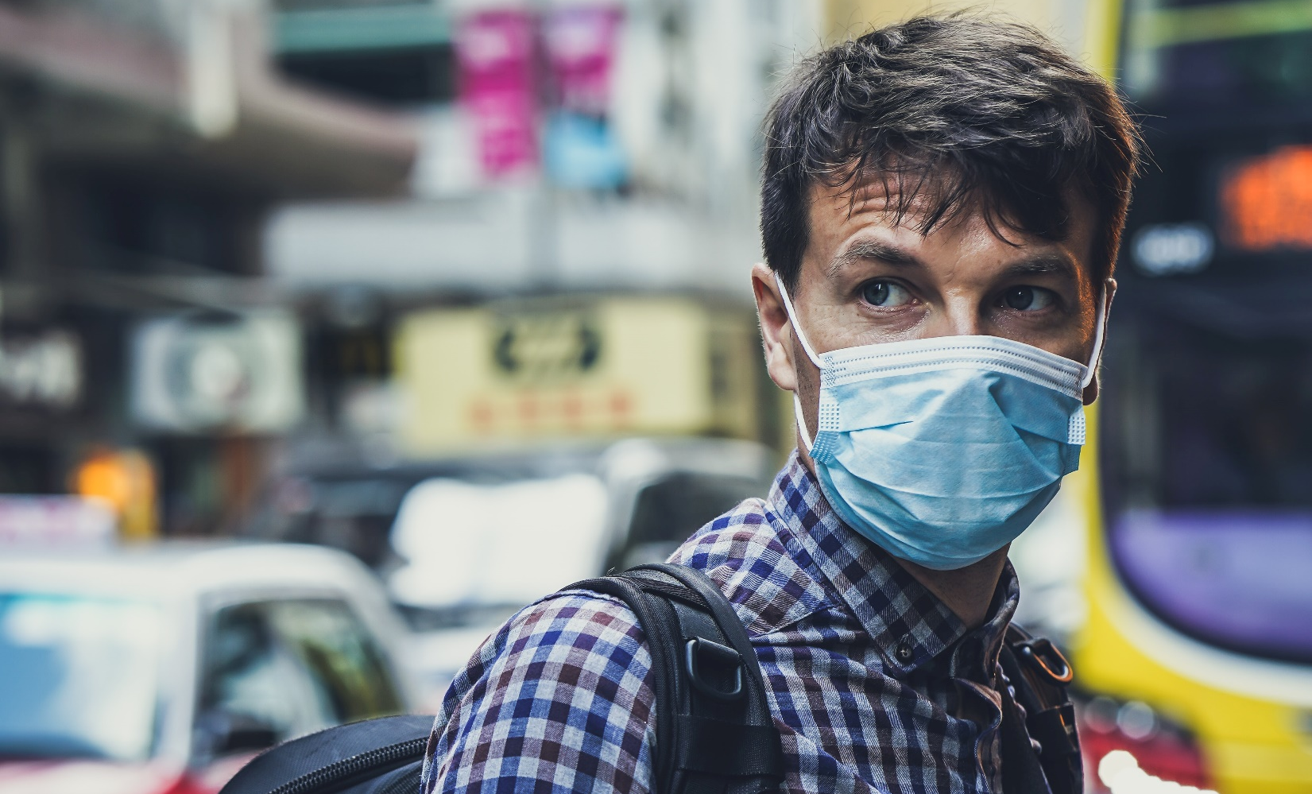


Open Questions When We Last Met
What will be the impact of the second round of COVID-19 closings?
What will be the new administration’s public policy impacts on Route1?
What will state and local public safety agency budgets look like in 2021?
Duration
Buy American
DoD funding
Additional public policy initiatives
Federal funding to the state level to address large budget wholes
Policy strings to be attached

Slide 16
Early 2021 Trends
ALPR is hot as an offering – usage of video is robust for parking and law enforcement.
Local government funding for public safety agencies has been moderate to robust.
Colleges and universities have had a “checkered start” to reopening.
Federal government funding for IT and cybersecurity initiatives has been reduced.
DOD focus on rolling out Office 365.
The global chip shortage started to impact the rugged device market in late February 2021 and will last at least into Q4 2021.
The rugged device OEM market is taking note of our “cradle-to-grave” business model.

Slide 17
FY 2021
01
Continue to Invest in ALPR
Sales, engineering, field services team and support.
05
Acquisition and Merger
Public safety accounts, engineering services and IP
02
ALPR Pricing
Evolve our pricing model to better reflect what we offer.
06
Talent
“New world” re talent movement, acquisition and retention.
03
EBITDA
Not a straight line to $1.0 mm per quarter. Invest to grow.
07
MobiKEY
Working in a cloud and Microsoft world
04
08
Launch New Video Offerings
Fixed ALPR, BWC and low-cost storage
Canadian Dollar
From 1.45 in Mar-20 to 1.24 in Apr-21.
Page 17

Slide 18
7300 N. Via Paseo Del Sur, Suite 202
Scottsdale, AZ 85258
Tony Busseri
President and CEO

