Slide 1


An advanced North American technology company that empowers their clients with data-centric solutions that drive greater profitability, improve operational efficiency and gain sustainable competitive advantages – all while emphasizing a strong cybersecurity and information assurance posture.
Q4 2019 Shareholder Call
April 23, 2020

Slide 2
Legal Notices
This presentation contains statements that are not current or historical factual statements that may constitute forward-looking statements. These statements are based on certain factors and assumptions, including, expected financial performance, business prospects, technological developments, and development activities and like matters. While Route1 Inc. (“Route1” or the “Company”) considers these factors and assumptions to be reasonable, based on information currently available, they may prove to be incorrect. These statements involve risks and uncertainties, including but not limited to the risk factors described in reporting documents filed by the Company. Actual results could differ materially from those projected as a result of these risks and should not be relied upon as a prediction of future events. The Company undertakes no obligation to update any forward-looking statement to reflect events or circumstances after the date on which such statement is made, or to reflect the occurrence of unanticipated events, except as required by law. Estimates used in this presentation are from Company sources.
© 2020 Route1 Inc., 8 King St. East, Suite 600, Toronto, Ontario M5C 1B5 Canada. All rights reserved.
See https://www.route1.com/terms-of-use/ for notice of Route1’s intellectual property.

Slide 3
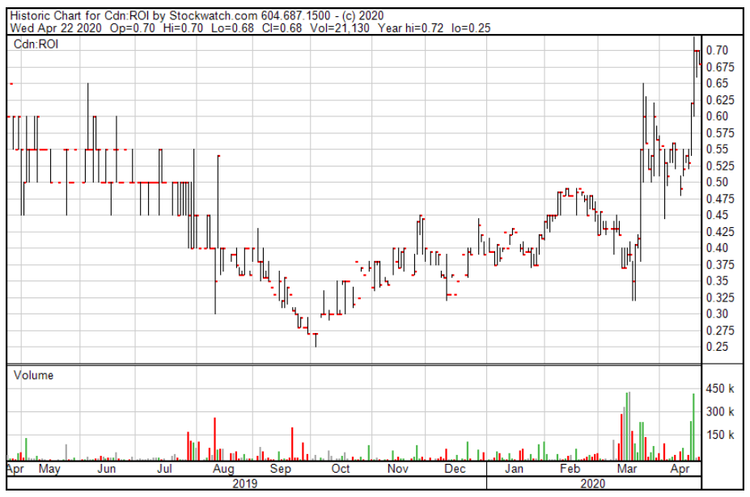
Company Snapshot
Incorporation Year | 2004
Stock Price | CAD $0.67 as at April 22, 2020
52 Week High / Low | CAD $0.25 to $0.70
Fully Diluted Common Shares Outstanding | 35.8 million
Market Capitalization | CAD $23.9
Employees | 54
FY 2019 Revenue | CAD $24.0 million
FY End | December 31
Offices | Toronto, Canada Denver, CO Washington, DC Boca Raton, FL Chattanooga, TN Chandler, AZ
Ticker | TSXV: ROI OTCQB: ROIUF
About Us
Route1 Inc., also operating under the tradenames GroupMobile and PCS Mobile is an advanced North American technology company that empowers their clients with data-centric solutions that drive greater profitability, improve operational efficiency and gain sustainable competitive advantages – all while emphasizing a strong cybersecurity and information assurance posture. Route1 delivers exceptional client outcomes through real-time secure delivery of actionable intelligence to decision makers, whether it be in a manufacturing plant, in-theater of operations or in a university parking lot. Route1 is listed on the OTCQB in the United States under the symbol ROIUF and in Canada on the TSX Venture Exchange under the symbol ROI. For more information, visit: www.route1.com.

Slide 4
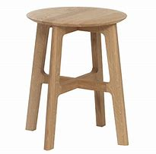
We Are an “Outcomes” Based Company
We deliver exceptional client outcomes through real-time secure delivery of actionable intelligence to decision makers, whether it be in a plant, in-theater or in a university parking lot. Our core competencies are:
Data Security and User Authentication
  Our IP: MobiNET (DEFIMNET), MobiKEY, DerivID
Data Acquisition and Analytics Technology
  Our IP: MobiNET, ActionPLAN, ScreenSTOP
  What we resell: Genetec AutoVu
Data Visualization – Rugged Devices and Accessories
  Our IP: NA
  What we resell: Various OEM’s rugged devices including fully and semi rugged laptops, fully and semi rugged tablets, rugged handhelds, docks and mounts, wireless products, printers and scanners, gateways and modems, and accessories
New Technology and Services
  Our in-house core capability: (a) Software development, (b) managed hardware services including TaaS, (c) on-premise client connectivity, and (d) hardware break and fix

Slide 5
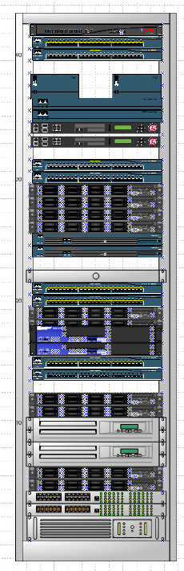

MobiNET: our Service Delivery Platform
What is MobiNET?
Multi-Tenant (MobiNET) or Single Tenant (DEFIMNET)
Secure Cloud: Best in class implementation of a system and networking framework
Identity – Authentication – Authorization: Public Key Infrastructure
PKI: Certificate Authority Hierarchy
Control and Signaling: Enabling the Applications
Provisioning and Administration: MAP
System Monitoring and Incident Response: R1Scout
Auditing and Reporting
Traversing Firewalls: MobiNET Switching Arrays
Securing Connections: CryptoPath
DEFIMNET Facts
High Availability
Designed for scalability; unlimited granular horizontal scalability across all components
Can be used for Route1 derived credential technology, DerivID
Can be used for other solutions needing authentication services
Not a single security breach in over a decade of field operations
Authorities to Operate (ATOs) from: OSD, Department of the Navy, USMC and Department of the Interior

Slide 6
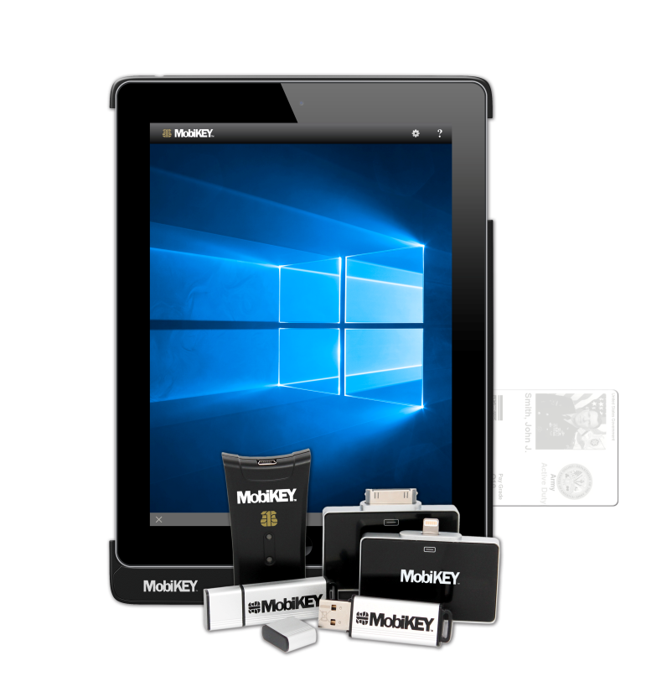




Security Software: MobiKEY
MobiKEY is a complete desktop, secure remote access technology that integrates multi-factor authentication and identity management in a mobile computing environment.
Technology Differentiators:
PIV card-based multi-factor authentication in compliance with HSPD-12 mandate.
Your data stays within your network’s perimeter. No DAR. No risk of data leakage.
Not a browser-based technology. Not vulnerable to Man-in-the-Browser attack vectors.
Not a VPN. No open inbound ports. Mitigates risk of penetration attacks.
No external nodes on your network. Mitigates risk of malware introduction.
Built with security as its first priority.

Slide 7
COVID-19 Impact at a High Level
The coronavirus pandemic has resulted in:
Substantially increased MobiKEY sales as government and business customers quickly move to work-from-home scenarios and look to Route1 for a highly secure remote computing technology.
Slowed the delivery of rugged device shipments to our US clients.
  OEMs have had some difficulties in assembling finished products as the supply chain from China has constrained production and deliveries of finished goods.
US based factory shutdowns during the month of April 2020 – small impact in March 2020. May is unknown.
Delayed installations of LPR projects – impacted in March and April 2020. May is unknown.
  Not an issue of losing a job or the gross profit; simply a timing issue.

Slide 8
Understanding the MobiKEY Impact: Subscribers
Note: Does not include the surge 15,000 users granted to JSP at no additional revenue

Slide 9
Understanding the MobiKEY Impact: Revenue
Note: The May and April 2020 values are based on sales already processed and assume for presentation purposes no additional MobiKEY subscriber growth during those months.

Slide 10
MobiKEY Client Notes
MobiKEY
Department of the Navy (DON)
  New DEFIMNET:
    New Navy ATO expected during Q2-20.
    New DEFIMNET to be used shortly after receipt of ATO.
Joint Service Provider (JSP)
  March 31, 2020 license renewed and paid.
  New contract structure is base year plus four, one year renewal options.
  Similar pricing to 2019 renewal.
    Surge user capability to from 4,000 to 19,000 users.
    With COVID-19 they are using the surge capability.

Slide 11
R & D Priorities
Since early March 2020, focus has been on:
  Expanding the number of users and concurrent users our MobiNET and three DEFIMNET platforms can support.
  The Department of the Navy ATO for the new DEFIMNET.
  Improving the JSP DEFIMNET based user experience.
  Released MobiKEY 7.0 – week of April 6, 2020.
  Development of the latest version for our MobiNET Switching Array.
  MobiKEY for Android, 64-bit support

Slide 12
Annual Operating Performance
In 000s of CAD Dollars | FY 19 A | FY 18 A | FY 17 A | FY 16 A | FY 15 A | FY 14 A | FY 13 A
Revenue | 24,010 | 26,231 | 6,070 | 7,447 | 6,397 | 6,078 | 5,433
Subscription Revenue and Services | 7,834 | 6,209 | 5,698 | 7,080 | 6,218 | 5,470 | 4,948
Gross Margin | 9,032 | 7,499 | 4,745 | 5,973 | 5,233 | 4,932 | 4,296
Gross Margin % | 38% | 29% | 78% | 80% | 82% | 81% | 79%
Expenses | 8,214 | 6,892 | 4,736 | 5,231 | 4,515 | 4,397 | 4,485
Operating Income | 818 | 607 | 9 | 742 | 718 | 535 | (189)
EBITDA | 1,941 | 1,275 | 401 | 1,203 | 1,152 | 901 | 72
AirWatch Litigation | (1,289) | (841) | (270) | (56) | 0 | 0 | 0
Net (Loss) Income | (554) | (434) | (610) | 330 | 728 | 637 | (343)

Slide 13
Quarterly Operating Performance
In 000s of CAD Dollars | Q4 A 2019 | Q3 A 2019 | Q2 A 2019 | Q1 A 2019 | Q4 A 2018 | Q3 A 2018 | Q2 A 2018
Revenue Subscription Revenue and Services Devices, Appliances and Other | 8,403 2,511 5,891 | 8,714 2,136 6,578 | 3,430 1,610 1,820 | 3,462 1,576 1,886 | 4,074 1,628 2,446 | 14,895 1,684 13,210 | 5,577 1,632 3,943
Gross Margin | 2,750 | 2,761 | 1,758 | 1,762 | 1,858 | 2,584 | 1,957
Gross Margin % | 33% | 32% | 51% | 51% | 46% | 17% | 35%
Expenses | 2,360 | 2,336 | 1,824 | 1,694 | 1,714 | 2,150 | 1,891
Operating Income | 390 | 425 | (66) | 68 | 144 | 434 | 65
EBITDA | 676 | 743 | 200 | 322 | 330 | 627 | 272
Net Income (Loss) | 510 | 1 | (553) | (512) | (355) | 188 | 13

Slide 14
Subscription Revenue and Services
In 000s of CAD Dollars | Q4 A 2019 | Q3 A 2019 | Q2 A 2019 | Q1 A 2019 | Q4 A 2018 | Q3 A 2018
Application Software | 1,202 | 1,182 | 1,196 | 1,186 | 1,169 | 1,193
Technology as a Service | 353 | 322 | 311 | 307 | 329 | 288
Other Services | 956 | 632 | 103 | 83 | 130 | 203
Total | 2,511 | 2,136 | 1,610 | 1,576 | 1,628 | 1,684

Slide 15
Operating Expenses
In 000s of CAD Dollars | Q4 A 2019 | Q3 A 2019 | Q2 A 2019 | Q1 A 2019 | Q4 A 2018 | Q3 A 2018
General and Administration | 1,133 | 1,157 | 1,015 | 997 | 942 | 1,350
Research and Development | 192 | 186 | 147 | 85 | 164 | 166
Selling and Marketing | 1,035 | 993 | 662 | 612 | 608 | 634
Total | 2,360 | 2,336 | 1,824 | 1,694 | 1,714 | 2,150

Slide 16
Gross Profit to Sales and Marketing Cost Ratio

Slide 17
Balance Sheet
In 000s of CAD Dollars | Dec 31 2019 A | Sep 30 2019 A | Jun 30 2019 A | Mar 31 2019 A | Dec 31 2018 A
Cash | 126 | 320 | 702 | 367 | 1,073
Total current assets | 6,206 | 6,106 | 6,219 | 5,106 | 3,664
Total current liabilities | 9,035 | 8,749 | 8,626 | 6,033 | 4,034
Contract liability (incl. in current liabilities) | 1,750 | 2,422 | 2,258 | 2,626 | 1,540
Net working capital | (2,829) | (2,643) | (2,407) | (927) | (370)
Fixed and intangible assets | 4,940 | 4,932 | 5,307 | 2,955 | 2,267
Total assets | 12,630 | 11,780 | 12,268 | 8,803 | 6,673
Bank debt and seller notes | 2,415 | 2,294 | 1,862 | - | -
Total liabilities | 11,650 | 11,307 | 11,415 | 7,943 | 5,208
Shareholders’ Equity | 980 | 473 | 854 | 860 | 1,465

Slide 18
Capital Expenditures
In 000s of CAD Dollars | FY A 2019 | Q4 A 2019 | Q3 A 2019 | Q2 A 2019 | Q1 A 2019
Leasehold Improvements | 1 | - | - | (3) | 4
Furniture and Equipment | - | - | - | - | -
Computer Hardware (including TaaS) | 578 | 56 | 172 | 152 | 198
Computer Software | 53 | 11 | 2 | - | -
Intangibles | 60 | 10 | - | 70 | 11
Total | 691 | 77 | 174 | 220 | 213
Summary of 2019 large investments:
  $388,000 for DON DEFIMNET
  $105,000 for TaaS assets: GMI
  $96,000 for internal and MobiNET infrastructure upgrades
  $40,000 internal costs capitalized for ScreenSTOP
  $30,000 for newly-awarded patent 1810-4010

Slide 19
MobileTek
MobileTek
Based in Cincinnati, Ohio.
Owned 100% by Howard Mandel, not that Howie Mandel.
Same business model as GroupMobile.
Closed April 9, 2020.
No purchase price.
  COVID-19 impact.
2019: Revenue of US $2.94 mm, gross profit of US $0.47 mm.
Three employees
  Two sales reps and one help desk

Slide 20
An advanced North American technology company that empowers their clients with data-centric solutions that drive greater profitability, improve operational efficiency and gain sustainable competitive advantages – all while emphasizing a strong cybersecurity and information assurance posture.
Q4 2019 Shareholder Call
April 23, 2020

